Slide 1
Ansbach Army Education Center
Education Administration Office
467-2817
Marc CB Maxwell, PhD
Education Services Specialist
467-2493
Glenn McMann
Education Services Officer
467-2378

Slide 2
Army Education Center, Bldg. 5817
0800-1630 Monday through Friday
Attend face-to-face college courses
Help with GoArmyEd and TA
Academic counseling
Research college information
Take CLEP tests, DANTES exams, or other tests
Military testing for DLAB, DLPT, SIFT, and AFCT
Visit Multi-Learning Facility

Slide 3
ON POST COLLEGE REPRESENTATIVES
Certificates
&
Associate Degrees
Associate Degrees
Bachelor Degrees
&
Graduate Degrees
Associate Degrees
Bachelor Degrees
&
Graduate Degrees
Graduate Degrees
POSITIVES:
They can discuss their programs face to face.
They can guide you through registration and class drops.
They can answer questions without delay.
You do not have to deal with time zones.

Slide 4
CREDIT FOR MILITARY TRAINING AND WORK EXPERIENCE
Joint Service Transcript
Credit recommendations for military schools
CLEP and DSST test scores
Credit recommendations for MOS work experience
JST TRANSCRIPT
Download your own copy from
https://jst.doded.mil/official.html

Slide 5
What is Tuition Assistance?
FINANCIAL ASSISTANCE PROGRAM
Active duty personnel - 100% up to $250/SH,
capped at $4000/fy.or 16SH
Up to 130SH for Bachelor Degree / 39SH for Master Degree
Provides all or a portion of tuition costs
Not a part of the GI Bill
No second degrees at the same level
Does not pay for books or fees
Classroom or Online Instruction
No courses beyond Masters Degree
Reimburse Army if you withdraw or fail
Officers - two year ADSO
Notes:
5
TA is the Navy’s financial assistance program for active duty service members pursuing voluntary education goals during off - duty hours. It pays a large part of the tuition at accredited high schools, colleges/universities, and vocational-technical schools. Ta does not pay for books or registration fees. TA can be used for both classroom and independent study/distance learning courses. It is managed by NETPDTC located in Pensacola FL. It is the parent command for all Navy College Offices and Marine Corps Education Centers.
- maintains the TA data base
- pays TA to educational institutions
- initiates TA reimbursement actions, such as grade request letters, letters of indebtedness/resolution, pay checkage
- maintains the Tuition Assistance Manual for Navy College Offices and Marine Corps Education Centers

Slide 6
What is Credentialing Assistance?
Up to $4000 PER FISCAL YEAR
Credentialing Assistance will pay for all necessary books, supplies, and associated materials required for an approved training course and/or exam. Soldiers may use both Federal Tuition Assistance (TA) and Credentialing Assistance (CA); however, the combined usage shall not exceed the $4,000 fiscal year limit.
Visit the Army Cool website for more details.
Notes:
TA RATES. TA funding rates are based upon federal law, Department of Defense (DoD) and Navy policy. Every member, regardless of service or program receives $4500 per fiscal year of tuition assistance.
b. High School Completion Courses measured in Carnegie hours - for service members who do not have a high school diploma, 100 percent of tuition cost.
C. Undergraduate, Graduate and Vocational Courses measured in semester or quarter hours - 75% of tuition not to exceed $187.50 per semester hour or $125.00 per quarter hour. Vocational/Technical courses measured in clock hours, not to exceed $12.50.

Slide 7
Military Spouse Education Benefits
The Pell Grant through the FAFSA
http://www.fafsa.ed.gov/
Overseas Spouse Education Assistance Program
https://www.aerhq.org/Apply-for-Scholarship/Spouse-Education-Assistance-Program
MyCAA
https://aiportal.acc.af.mil/mycaa/Default.aspx
Notes:
5
TA is the Navy’s financial assistance program for active duty service members pursuing voluntary education goals during off - duty hours. It pays a large part of the tuition at accredited high schools, colleges/universities, and vocational-technical schools. Ta does not pay for books or registration fees. TA can be used for both classroom and independent study/distance learning courses. It is managed by NETPDTC located in Pensacola FL. It is the parent command for all Navy College Offices and Marine Corps Education Centers.
- maintains the TA data base
- pays TA to educational institutions
- initiates TA reimbursement actions, such as grade request letters, letters of indebtedness/resolution, pay checkage
- maintains the Tuition Assistance Manual for Navy College Offices and Marine Corps Education Centers

Slide 8
VA Transfer of Benefits
Service Member can transfer Post 9/11 G.I. Bill to dependents
Requirements:
Must have served 6 years
Must agree to 4 year ADSO (service obligation)
For more information, please visit www.va.gov
Call VA Benefit Advisors in Vilseck DSN: 476-2817 CIV: 09802-83-2817

Slide 9
Army Personnel Testing
For Army Testing Center,
please contact
Mr. Julius Clark: julius.j.clark3.ctr@mail.mil
Or call DSN: 467-2730
CIV: 09802-83-2730
Armed Forces Classification Test (AFCT)
Armed Services Vocational Aptitude Battery (ASVAB)
BMST
Defense Language Aptitude Battery (DLAB)
Defense Language Proficiency Test (DLPT)
Oral Proficiency Interview (OPI)
Pre-TABE
Post TABE
SIFT
Notes:
These military examinations (DLPT, DLAB, AFAST, AFCT, ASVAB, typing and dictations) are provided through the Testing Branch. Soldiers are required to call in advance to schedule a test dated.

Slide 10
DANTES/National Testing Center
Defense Activity for Non-Traditional Education Support
Interest Inventories (DANTES)
Test Proctor Services
Pre GED and GED
GMAT
DSST
CLEP
For questions or to schedule a testing appointment, please contact UMGC at DSN: 497-3816
CIV 09802-83-3816 or email:
ntcansbach-europe@umuc.edu
GRE – please contact:
Prometric in Munich, Berlin, or Frankfurt
Notes:
Testing branch also offers a wide variety of civilian examinations to include entrance examination into Undergraduate and Graduate Programs, College Placement exams, College Credit exams through DANTEDS and CLEP Programs. TABE and Test Proctor Services for online and distance education programs are available.

Slide 11
FUNCTIONAL ACADEMIC SKILLS TRAINING (FAST)
110 or higher GT is required for many programs
FAST Classes can help raise your GT Score.
Focus is on Math and English
FAST Classes are offered in both Katterbach and Illesheim
Instructor guided but personalized

Slide 12
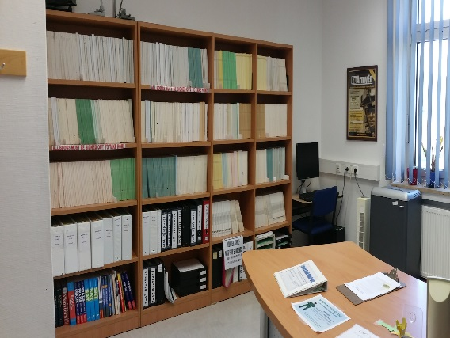
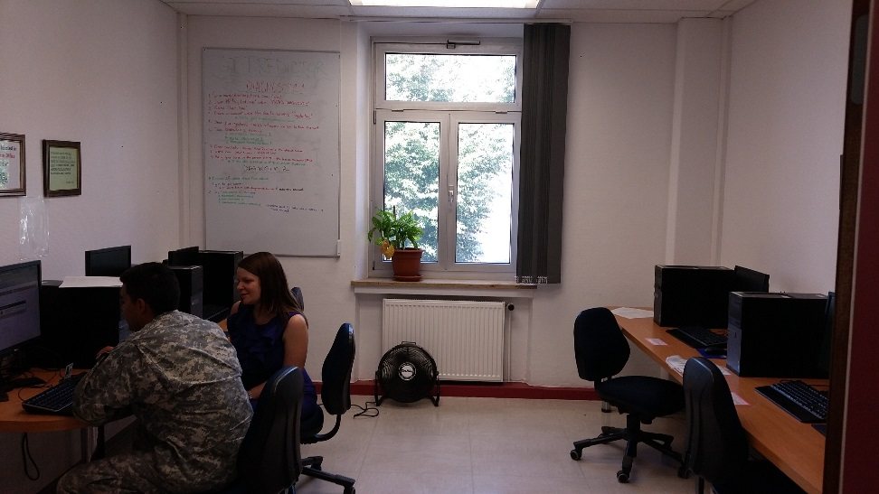
LOCATED: BLDG 5817, RM 250
Multi-Learning Facility (MLF)
Hours of Operation :
MON - FRI: 0800 – 1630
Email, research, word documents, scanner, printing, and more.
GT Test Preparation
CLEP and DANTES Preparation
APT Preparation
GoArmyEd assistance

Slide 13
“LIKE” US ON FACEBOOK!
Be the first to get updates and information!
Know about registration dates!
Find out what classes are being offered!
Ask questions!
“Like” us now!

