Slide 1
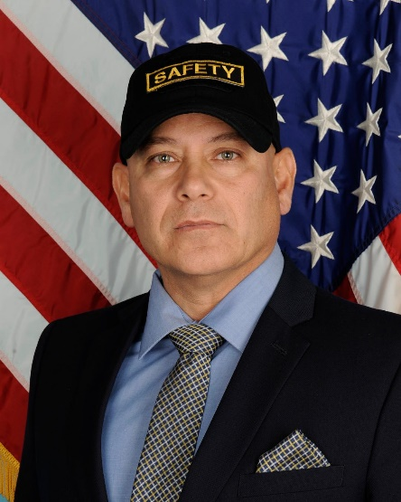

USAG ANSBACH SAFETY INBRIEF
USAG Ansbach Safety Office
Bldg 5251 Barton Barracks
2nd Floor Rooms 207/212
DSN 468-7780/1670/7240
Commercial 0981-183-7780/1670/7240
Robert Garza
Safety Director
Guenter Korn
LN Safety Specialist
Notes:
Hello. I am Mr. Garza, the Garrison Safety Director. Welcome to Ansbach! Here is the contact and location information for Mr. Korn and myself.

Slide 2
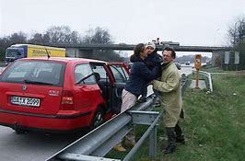
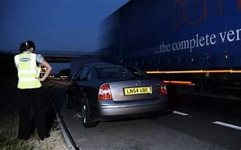
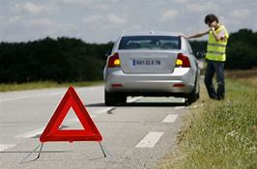
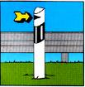
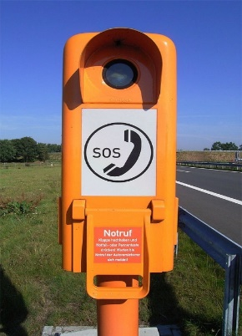
DRIVING EMERGENCIES
If your vehicle becomes disabled….
1. Get as far to the right as possible. 2. Stay away from car, get behind guardrails.
3. Put on your vest - visibility is crucial.
4. Deploy warning triangle:
50 meters in the city.
100 meters on land strassen.
150 to 400 meters on autobahn.
On curves, place it before the curve to help drivers anticipate your situation.
Sends location to operator.
Shows direction of travel.
Notes:
As you complete your online driver’s training, you will see that driving in Europe is a little different than driving in the U. S. Here are a few things to remember if you experience a mechanical problem with your vehicle:
1. Get as far to the right as possible. 2. Stand a safe distance from your car. 3. Put on your safety vest. 4. Set out your warning sign.
To use the orange telephone posts, simply pick up the hand-piece and it will notify the emergency operator of your location. They will send someone out to help.

Slide 3
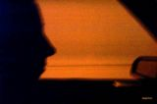
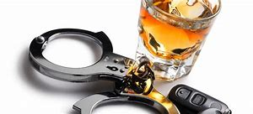
DRUNK & DROWSY DRIVING
Don’t Drink and Drive.
Designated Driver (Not even 1 drink).
Don’t rationalize your drinking by using the 1 drink per hour rule - that has led to many DUIs.
Use the train or get a Taxi.
Call a buddy who is sober or your Chain of Command.
Always have a plan.
Penalties - Suspension: 90 days for BAC of 0.5 -0.79.
Revocation: 1-year for operating a motor vehicle with a BAC of 0.8 or higher.
Dangers of drowsy driving:
Judgment and vision are impaired.
Reaction time is slowed.
Overall awareness and performance are impaired.
Nodding off may cause you to lose control of your vehicle.
Who’s at risk?
Shift workers
People taking medication
Marathon drivers
Avoid the situation.
Plan ahead – get some rest
Avoid traveling alone
Plan for stops
Have a contingency plan
Notes:
Unless you’re new to the Army, you have probably heard quite a few “drinking and driving” safety briefings. Not much to add expect to encourage you to avoid letting it happen to you. Same goes for drowsy driving. Get plenty of rest before heading out on long road trips.

Slide 4
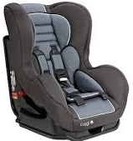
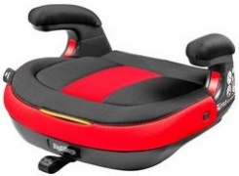
CAR SEATS
Some U.S. Child Car Seats are not compatible with German cars and vice versa.
German law states that children 11 years or younger, or shorter than 150 centimeters (4 feet, 11 inches) are required to:
Use suitable child-restraint devices that have been approved by either the ECE-R 44/03, ECE-R 44/04 or by DOT.
Be seated in a rear seat if the POV has one (AER 190-1). Exception to this if the back seat is full.
Group Weight Age Type Required
0 0 - 10 kg until 9 months full chair (infant)
I 9 - 18 kg 9 - 36 months full chair (toddler)
II 15 - 25 kg 3 - 6 years booster seat
III 22 - 36 kg over 6 years booster seat
Age: below 12 years
Height: below 1.5 m
Notes:
U.S. car seats are not compatible to European cars and vice versa. Please use the right type of car seat for your vehicle. Children must be at least 12 years old to ride in the front seat. The exception to that is if your back seat is already full of 11 years olds or younger.

Slide 5
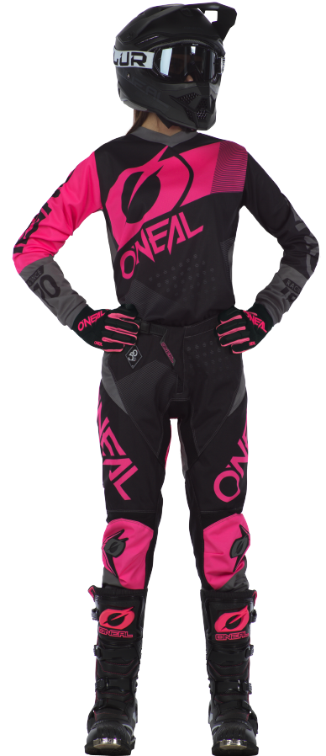
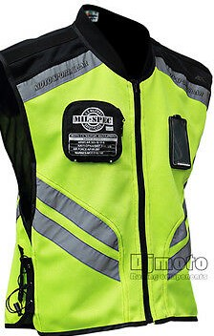
MOTORCYCLE SAFETY
Active duty riders must wear all protective gear as stated in AER 190-1!
Helmet
Visor or impact resistant sunglasses
Long-sleeved upper garment
Pants
Sturdy over the ankle footwear designed for riding – no tennis shoes
Full-fingered leather or Kevlar gloves
Within USAREUR AOR, must wear a reflective vest designed for MC riders.
Notes:
The proper motorcycle gear is always an important aspect of safe riding. Here, in U.S. Army Europe, you MUST wear a high visibility vest with integrated reflective material. For active-duty its a universal requirement. For DA Civilians, contractors and dependents it applies on U.S. installations.

Slide 6
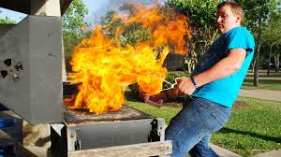
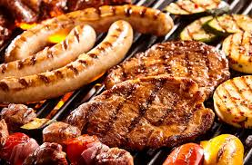
BARBECUE GRILL SAFETY
When using barbeque grills:
In housing areas stay at least 15 feet from buildings and overhangs.
Cook away from children’s play areas and pedestrian traffic areas.
Never use a grill indoors or on balconies.
Use a fat-dripping pan.
Don’t pour lighting fluid on a fire.
Never use gasoline as lighting fluid.
Store propane tanks properly.
Allow grill to cool completely prior to storage.
Use abrasive sponge to clean. Wire brushes may leave bristles behind.
Have a serviceable FIRE EXTINGUISHER available!
Notes:
Grilling season is here! Enjoy your cookouts but please keep your focus on safety! Grills must be at least 15 feet away from all structures, overhangs and vegetation. And NEVER, EVER use gasoline to start a fire. May every cookout bring happy and safe memories of your time in Germany.

Slide 7
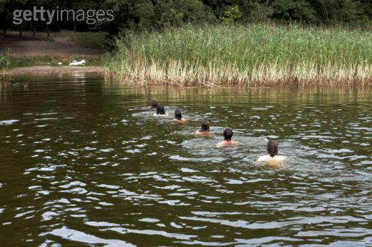
Water and swimming Safety
Swim only in authorized swimming areas (AE Circular 190-24).
Never swim alone - Swim with a buddy.
Know your limitations! Swim within your ability.
Don’t swim after drinking alcohol.
Local outdoor swimming areas are often murky and dark hiding possible objects that can cause injury when diving or wading.
Water temperatures are often colder in Germany which can contribute to swimmer fatigue.
Non-swimmers, don’t be embarrassed to wear a personal flotation device (PFD).
KEEP Water and swimming Safety IN MIND when traveling to other European locations.
Notes:
Lakes and ponds in Germany never really warm up and are always a little cold. Never swim alone and always stay within your abilities. Non-swimmers should play it safe and always wear a personal flotation device when going into the water.

Slide 8
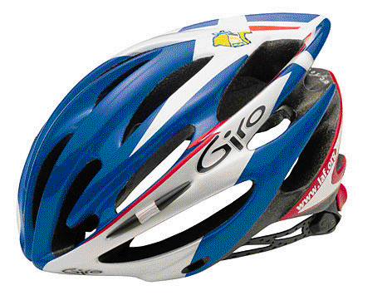
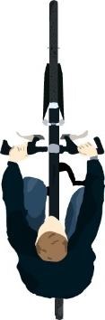
BICYCLE SAFETY
  Stay as far to the right as SAFELY possible.
  What impacts “safety”?
    Parked cars.
    Availability of a bike lane.
    Width of shoulder.
    Trash & debris on the road.
    Traffic flow.
    Traffic signals.
    Visibility.
  How to stay “safe”:
  Stay alert at all times.
  Know the traffic rules.
  Do not ride in the left lane.
  Do not ride against traffic.
  Apply common sense.
Must wear a helmet and light colored or reflective clothing .
NEVER use head phones while riding (AR 385-10 & AER 190-1).
  Wear a CPSC (post-1999) or Snell/ANSI Approval helmet.
  Ensure it is properly fitted.
  Check the shell for cracks.
  Avoid storing it in high heat areas.
  Replace it following a crash.
Notes:
Before riding, please make sure that your bike meets all of the German safety requirements. Always wear a helmet and bright colored or reflective clothing.

Slide 9
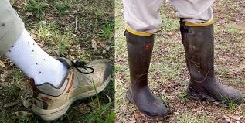
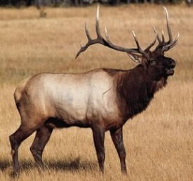
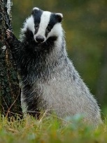
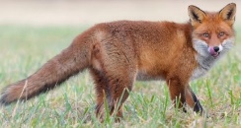
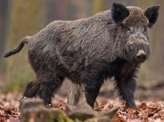
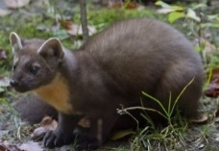
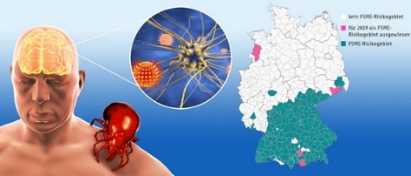
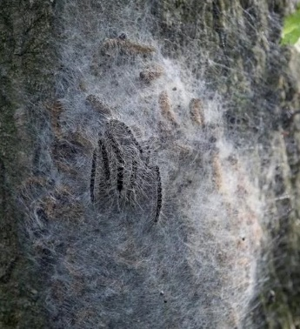
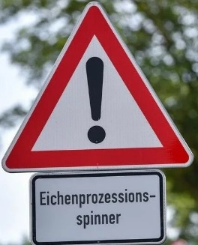
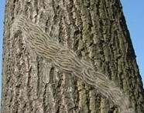
WILDLIFE
Animals
Ticks
Carry Lyme Disease, Rocky
Mountain Spotty Fever, Southern Tick
Associated Rash Illness (STARI)
FSME (Fruhesommer-meningo-enzephalitis) can result in meningitis or even worse: nerve damage, encephalitis and myelitis.
No cure for FSME.
February to July are high density periods for animals in forested areas.
For your safety and theirs, avoid wildlife.
If you encounter an animal on the road while driving don’t swerve to avoid it. Hitting an oncoming vehicle or 10 inch pine tree will hurt much more.
Prevent Tick Bites
Avoid woody and
bushy areas with high grass and leaf litter.
Walk in center of trails.
Wear light colored clothing
Tuck Pants/Pull Up Socks.
Oak Processionary Caterpillars
Nest
Look for warning signs at entrance to trails.
They release hairs that contain venom that can irritate eyes, nose, throat and cause skin rash.
If you see a nest, stay clear and do not disturb.
If rash occurs, seek medical help.
In the open
Notes:
Many parts of Germany have forests that contain wildlife. Should you encounter any, stay away from them. Ticks are common here so avoid walking through tall grass and weeds. Oak Processionary Caterpillars are also found in the woods. Avoid their nests and do not disturb them.

Slide 10

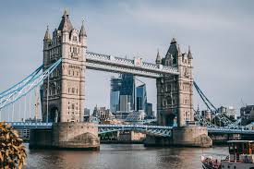
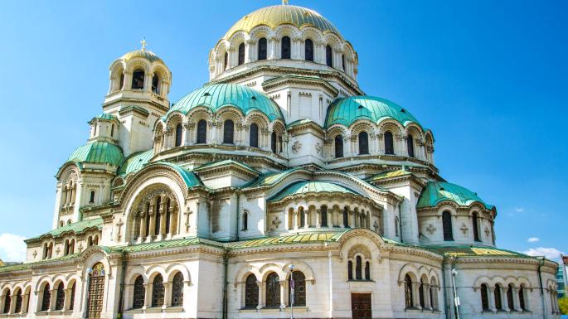
TRAVELING IN EUROPE
Learn about the political atmosphere and criminal activity at your planned destination.
Some countries, such as Turkey, are off-limits. Check the Foreign Clearance Guide (CAC required).
Register with the U.S. State Department’s Smart Traveler Enrollment Program (STEP) at https://step.state.gov/step/ .
Always practice basic personal safety and security measures:
Never flash cash.
Be situationally aware when using ATMs.
Know local emergency numbers and basic phrases.
Avoid ill-lit, sparsely populated areas at night.
Carry your hotel’s business card.
Americans are not popular every where - keep a low
profile.
Notes:
Traveling in Europe can be exciting but you must always keep your safety in mind. Some areas are more secure than others. Register with the U.S. State Department’s Smart Traveler Enrollment Program known as STEP. You can receive email notifications regarding safety and security conditions for your planned travel locations.

Slide 11

Closing Remarks
Notes:
Thank you very much for your attention. If you have any questions, please refer to our contact information on the first slide. Have a safe overseas tour!

