Slide 1
American Red Cross
Service to the Armed Forces
serving Tower Barracks, Rose Barracks, Hohenfels, Ansbach, & Garmisch
Notes:
Introduce yourself, name, title, how long with Red Cross in Bavaria. Advise that our station covers Grafenwoehr, Vilseck, Hohenfels, Ansbach, and Garmisch (4 offices, Garmisch is just a satellite station)

Slide 2
Agenda
Family Contact Card
Emergency Communications
Video
Office Contact info
Notes:
Review agenda. Already completed the contact card, but we’ll explain important services, the biggest takeaway is Emergency Communications (Red Cross messages).

Slide 3
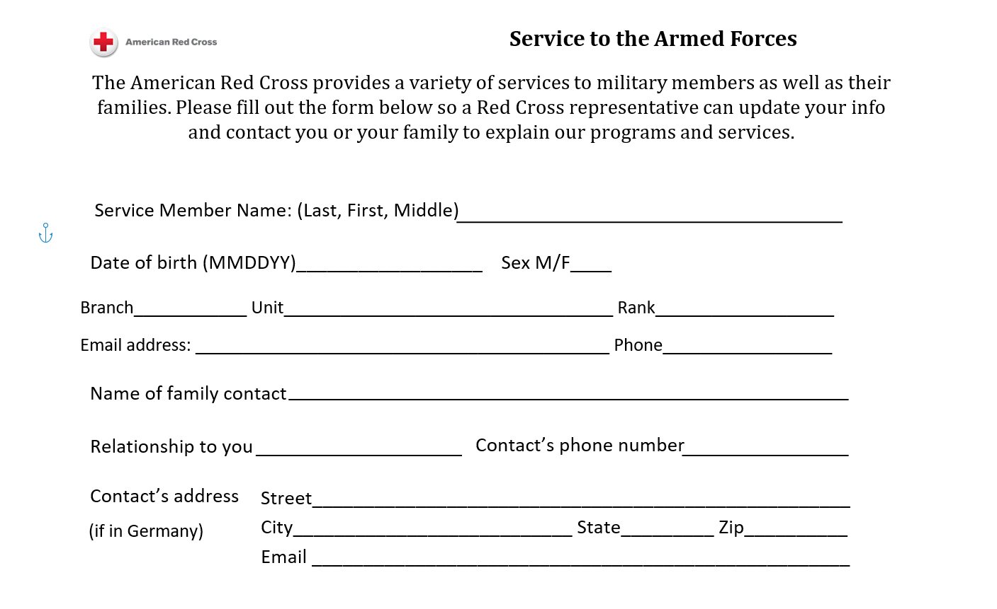
BDE, BN, CO, Troop, etc
Notes:
The Red Cross strives to provide military families with support information at vital times during their service member’s military career. To this end, there are a few events in which the Red Cross uses the Family Contact Cards to engage military families: at MEPS, Newcommer’s Orientation and predeployment events. Family Contact Cards are important as they help the Red Cross have up to date information readily available for Service Members in the event of the need for a Red Cross Message.
Please fill out the form completely and legibly. The top section is the Service Member’s information, the bottom section is for a family point of contact. Please provide as much unit information as possible, including unit location- Vilseck, Graf, Aachen, etc. This helps expedite the delivery of the message. The Red Cross team will reach out to your family member you write down to provide them information on Red Cross services and information on how to start a Red Cross Message if needed. You don’t need to fill out family member information at the bottom if the family is not stationed here in Germany. These cards are kept confidential, we take these cards back to the office, lock them up, enter them within 2 weeks and shred.

Slide 4
Emergency Red Cross Message
The role of the Red Cross is to provide service members and military authorities with objective, timely, confidential, factual, complete and verified information on emergency situations that enable them to make an informed decision.
Emergency Red Cross Messages do not replace normal communication.
How Do I start a Red Cross Message?
Call or visit one of the local offices
Call the 24/7 Hero Care Center: 1-877-272-7337
Submit online at http://www.redcross.org/get-help/military-families/emergency-communication
Through the HeroCare App
Notes:
While you fill out the contact card, please watch this short video on Red Cross Services and Red Cross Emergency Communication Messages.
The American Red Cross provides timely, factual reports about family emergencies, to service members wherever they are stationed. Emergency Communications – serve as the link between families back home dealing with a crisis and their loved ones serving in the military. The Emergency Communications Center and American Red Cross offices worldwide provide Emergency Communications around the clock.
Anyone can initiate a Red Cross message by phone, online, or in person. You’ll see this contact number again at the end. Now we’ll explain what a Red Cross message is and the process for it.

Slide 5
Notes:
https://vimeo.com/421177255/2fc76a2ddb
Link to video if it does not work

Slide 6
How Emergency Messages Work
Initiate
An emergency happens in the family.
Verify
ARC obtains basic information on service member and about the emergency.
ARC verifies emergency with medical facility and/ or qualified personal.
Deliver
Message is sent to service member’s command via ARC channels. ARC cannot provide printed message.
Leave decision is made by command team.
Anyone can contact ARC to initiate message.
Notes:
If you’ve never had a Red Cross message, this is how it works. Or if it’s been a long time, this is a good reminder. This is our system for family emergencies and it’s especially important for you OCONUS because this not only grants emergency leave but eligible circumstances may also receive unit funding to travel to home of record.
First, an emergency happens in your immediate family. Important note: grandparents are eligible for Red Cross messages but not considered immediate family by the DoD so talk to your chain of command about the relationship. They may grant regular leave under emergency circumstances and you can take Space A on military flight or pay for your own flight (or request financial assistance from AER). Emergencies= unexpected, time critical, life threatening, short-term, disrupts the norm, requires service member’s attention.
Family/service member/first sergeant/healthcare professional (ANYONE) can initiate a Red Cross message through phone, website, app, walk-in.
ARC collects information about SM and emergency (even if your info is saved in system, helpful if family has it on hand).
We verify emergency with a professional so the emergency must be reported. For example, if an assault occurred, we can verify with a police department but only if the family member reported it. We serve as a kind of “doctor’s note” providing accurate information to command.
Message is delivered by phone only. We can never print or email Red Cross messages. We read it word for word usually to staff duty who writes it down and passes it to the appropriate person.
Other relevant note: Births- Red Cross sends emergency messages only, not routine in-labor notifications. Leaders often request a message and tell their soldiers to just wait until mother goes into labor, but we can only send if there is a medical emergency or after the fact, a birth announcement.

Slide 7
Required Information
Basics:
Must be an emergency
Situation must be a verifiable emergency.
Situation must meet the criteria for eligible recipients.
Service Member Information:
Full legal Name
Rank & Branch of Service
Phone number & email
Social security Number & Date of Birth
Military Unit, troop, unit address
Person/ staff duty to deliver the message to
Where the Service member is deployed/ Rear D information
About the Emergency:
Name & contact information for immediate family member experiencing the emergency
Nature of the emergency
Local Point of Contact- family/friend
Where/ who can verify the emergency ( hospital, doctor, social worker, funeral home )
Notes:
Anyone can start an Emergency Communication Message they must have all of the service member’s information to do so.
An emergency is defined as "a sudden, generally unexpected, occurrence of a time-critical and short-term nature that disrupts or threatens to disrupt the norm and that demands immediate action or attention," Generally speaking these are Birth, Death, Illness, breakdown in Childcare Plan, Unforeseen Financial Emergency, other emergency situation requiring the service members immediate attention.
Messages must involve an immediate family member. This is defined as Parent, Sibling, Child, Spouse, Grandparent, other family member with extenuating circumstance (for example, lived with uncle as primary caregiver for 5 years prior to joining military and no parent in the home). We can make an exception in extraordinary circumstances, but we have to know up front. We will not send a clarification message after the fact. So if the emergency involves the uncle that raised you, the person initiating needs to give us that information during the initial intake call.
The American Red Cross provides a third-party verification of the emergency for the service member and command to enable them to make an educated decision regarding leave. The Emergency must be verified by a professional person who had the authority to provide that information or service. These include: Doctor, Lawyer, Social Worker, Funeral Director, RN on behalf of Doctor, Utility Worker, Landlord, Member of Clergy (death and mental health) other “Licensed Professional” who is qualified to speak on matter. Verifications may also be provided when needed to obtain emergency financial assistance from a military aid society.
When Starting a Message the caller should have the following information available.
Service Members Info: Full name as it appears in DEERS, Rank/rating, Branch of service, Social Security number OR full date of birth, Current Military UNIT and Physical Location (not APO ) Information about the deployed unit and home base unit (for deployed service members only)
We also need Information on family member Red Cross can talk to in the community emergency is occurring (usually the initiator).
***Remember, the more information we get from the caller, the more quickly we can find you and deliver the message.***
UPDATE YOUR FAMILY EVERY TIME YOUR INFORMATION CHANGES!

Slide 8
After ECM Delivery
Military Commanders/ supervisors make the decision regarding what type, if any, leave is granted.
Financial Assistance:
The Red Cross does not provide funding for travel.
Government funded emergency leave travel is authorized for Service Members and their Dependents stationed OCONUS in accordance with the Joint Travel Regulation.
The American Red Cross partners with Army Emergency Relief and will assist Service Members in contacting AER about their services if needed.
If needed, Service Members may be eligible for a grant or loan through AER (Army Emergency Relief): visit or call your local ACS for more information or at https://www.aerhq.org/
For after hours support for AER please call the HeroCare Network:
1-877-272-7337
Notes:
Emergency communication messages do not replace normal communications.
Starting a message does not guarantee that the service member will be granted emergency leave.
American Red Cross partners with Military Aid Societies for Financial Assistance

Slide 9
Other Red Cross Services
Volunteer & Leadership Opportunities
Special Events
Administrative support
Public Relations/Marketing
Outreach
Emergency Communications
Youth Programs
Health Care Professionals
Disaster Preparedness
Disaster Education courses
Resiliency Programs
CPR Training
Instructor Training
Community Outreach
Get started as a volunteer by visiting: https://volunteerconnection.redcross.org

Slide 10
Rose Barracks, Bldg 162, 09662-83-1760
Tower Barracks, Bldg 150, 09641-83-1760
Hohenfels, Bldg ,259, 09472-83-1760
Ansbach, Bldg 581, 09802-83-2136
Email: Grafenwoehr@redcross.org Vilseck@redcross.org
Hohenfels@redcross.org
Ansbach@redcross.org
HeroCare Network: 1-877-272-7337
or redcross.org/herocarenetwork

